Slide 1
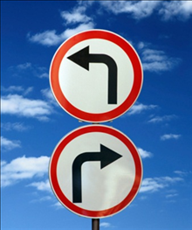
Real Obedience: a choice and a blessing?
Obedience in
Motives
“If you love me you will obey what I command.” John 14: 15

Slide 2
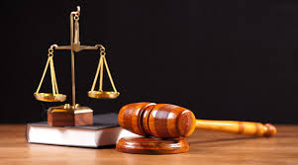
Motives and Mixed Motives:
“actus reus non facit reum nisi mens sit rea,”
=
"the act is not culpable unless the mind is guilty"

Slide 3
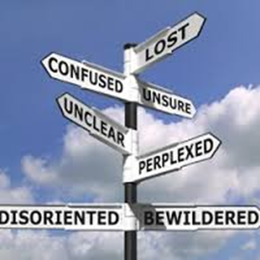
Motives and Mixed Motives:
Mixed Motives
The Pharisee and the Tax Collector –
which are you?

Slide 4
The Origin and Problem with our Motives:
“ There are some who naively cling to the nostalgic
memory of God. The average churchgoer takes a
few hours of the week to experience the sacred…..
but the rest of the time, he is immersed in a society
that no longer acknowledges God as an omniscient
and omnipotent force to be loved and
worshipped……

Slide 5
The Origin and Problem with our Motives:
“…..today we are too sophisticated for God. We
can stand on our own; we are prepared and
ready to choose and define our own existence.”
“If God is dead, then the late 20th
Century buried Him.” Ralph Georgy
Minneapolis Star Tribune 12.09.1994

Slide 6
The Origin and Problem with our Motives:
The Origin – Gen 2: 16-17, Jer. 17: 5, Luke 18: 4
The Problem
‘This is what the Lord says: “Let not the wise boast of their wisdom or the strong boast of their strength or the rich boast of their riches.’
Jeremiah 9: 23.

Slide 7
The Origin and Problem with our Motives:
Wisdom – 1Cor. 4: 7
‘What we suffer from is humility in the wrong
place. Modesty has moved from the organ of
ambition. Modesty has settled upon the organ of conviction; where it was never meant to be. A man was meant to be doubtful about himself, but undoubting about the truth; this has been…

Slide 8
The Origin and Problem with our Motives:
‘…exactly reversed. Nowadays the part of a man that a man does assert is exactly the part he ought not to assert – himself. The part he doubts is exactly the part he ought not to doubt – the Divine Reason.’
G.K Chesterton, Orthodoxy.

Slide 9
The Origin and Problem with our Motives:
Strength
Riches
Jeremiah 17: 5-6

Slide 10
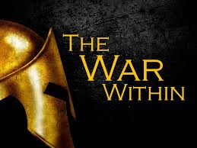
The Battle of our Motives: Romans 7: 15-24
‘What a wretched man I am! Who will rescue me from this body that is subject to death?’
‘Thanks be to God, who delivers me through Jesus Christ our Lord!’
Romans 12:
24-25a

Slide 11
The Battle of our Motives: Romans 7: 15-24
‘So then, I myself in my mind am a slave to God’s law, but in my sinful nature a slave to the law of sin.’ Romans 12: 25b
What is……..

Slide 12
The Solution for our Motives: Acts 6: 1-7
The Salvation of Obedience – Hebs. 11: 6; Gal. 5: 6b; & John 14: 15
Our Hearts – Jer. 17: 9, 7-8; Matt. 6: 19-20; Ezk. 36: 26
Our Minds – 1 Cor. 2: 16; Phil. 4: 6-9; Roms. 12:2; Roms. 8: 5-8
Our Lord – Roms. 7: 25

Slide 13
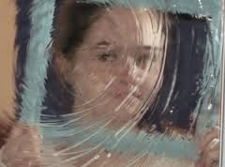
Real Obedience: In Motives
Reward – Jer. 17: 10; Luke 18: 14; & 1 Cor. 4: 5
‘As water reflects the face, so one’s life reflects the heart.’ Proverbs 27: 19
What’s our reflection?

